Slide 1

ANDROID PUZZLE LOCK

Slide 2
CONTENT
Introduction
Proposed System
Why Android?
Working with Android
Working Flow of our Project
Screens

Slide 3
INTRODUCTION
We have developed an application which can be integrated with other APIs for enhancement of security.
User gives image which is used as another measure for authentication.
We have also implemented a timer which ensures the puzzle is solved within a specific amount of time.

Slide 4
PROPOSED SYSTEM
Puzzle Locking System allows the user to use an image and set it as an authentication measure.
The Image is divided into several parts and represented as a matrix of cubes for authentication in any order.
In this application if the puzzle is solved within certain time and is correct you are directed to success page.
The API can be used for implementing high level security.

Slide 5
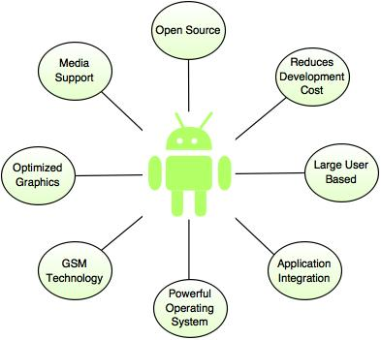
WHY ANDROID APPLICATION?
Notes:
It also offers powerful code editing
emulator

Slide 6
WORKING WITH ANDROID STUDIO
Languages – Java and Kotlin
Can work with various predefined
activities
Major Components –
Activity File and its associated .java file
Manifest file
Build gradle
Notes:
Login activity Google maps activity
Empty activity

Slide 7
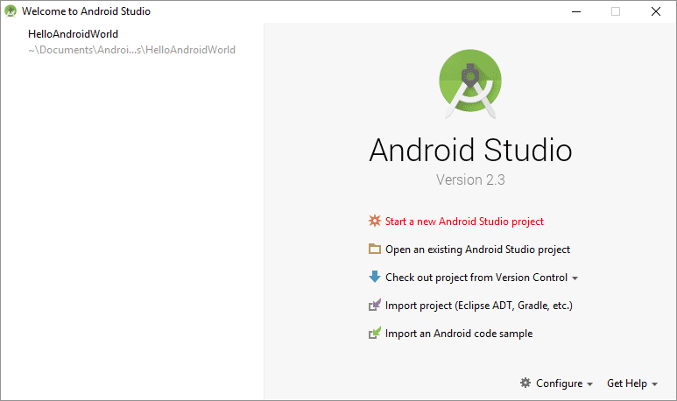
ANDROID STUDIO

Slide 8
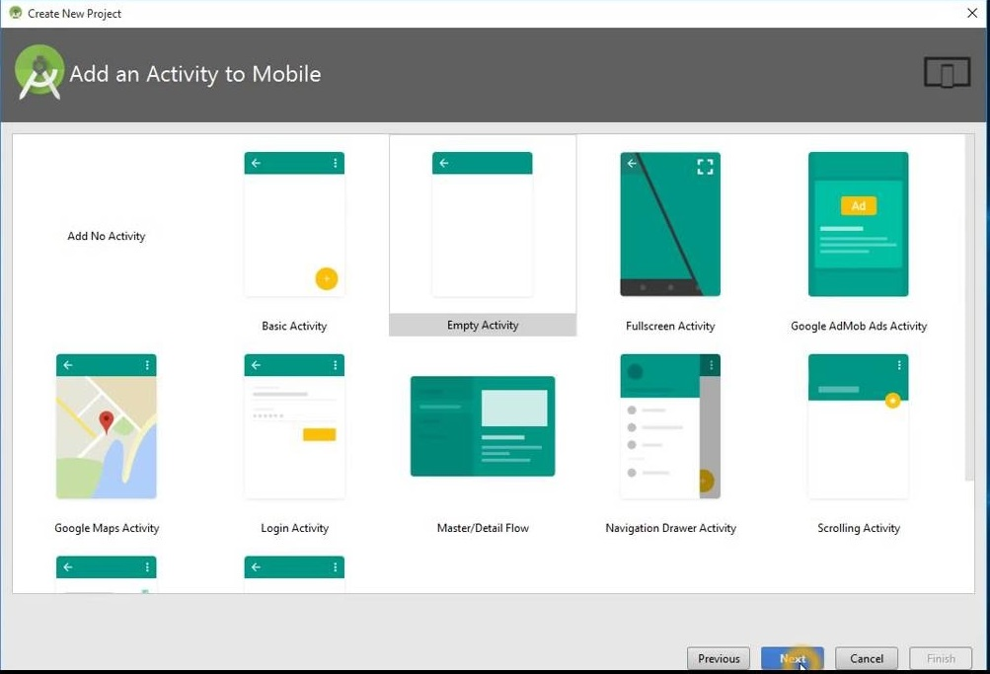
ANDROID STUDIO

Slide 9
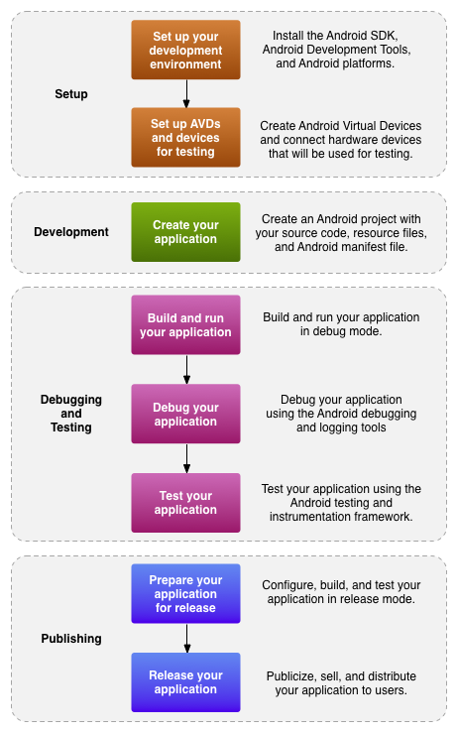
Android Studio : Working Flow

Slide 10
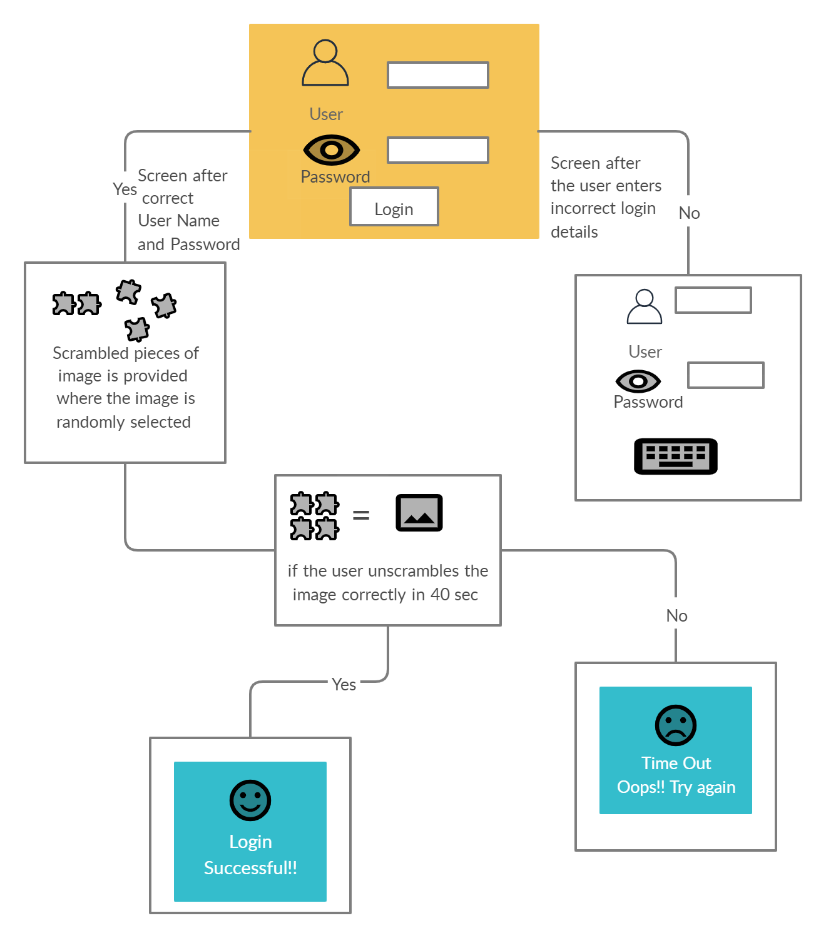
FLOW OF PROJECT

Slide 11
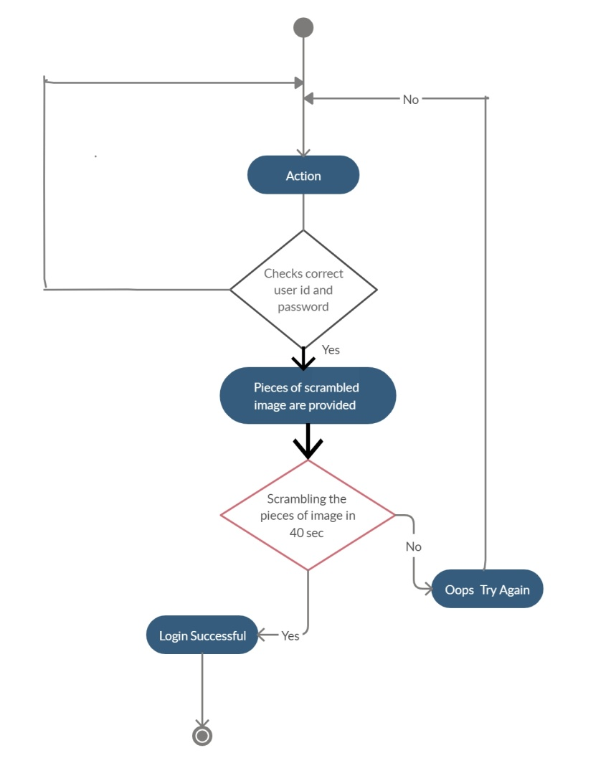
Activity Diagram

Slide 12
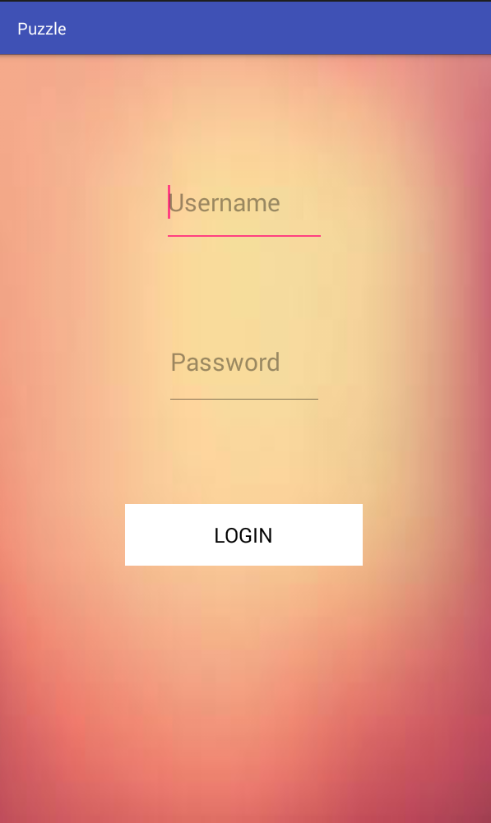
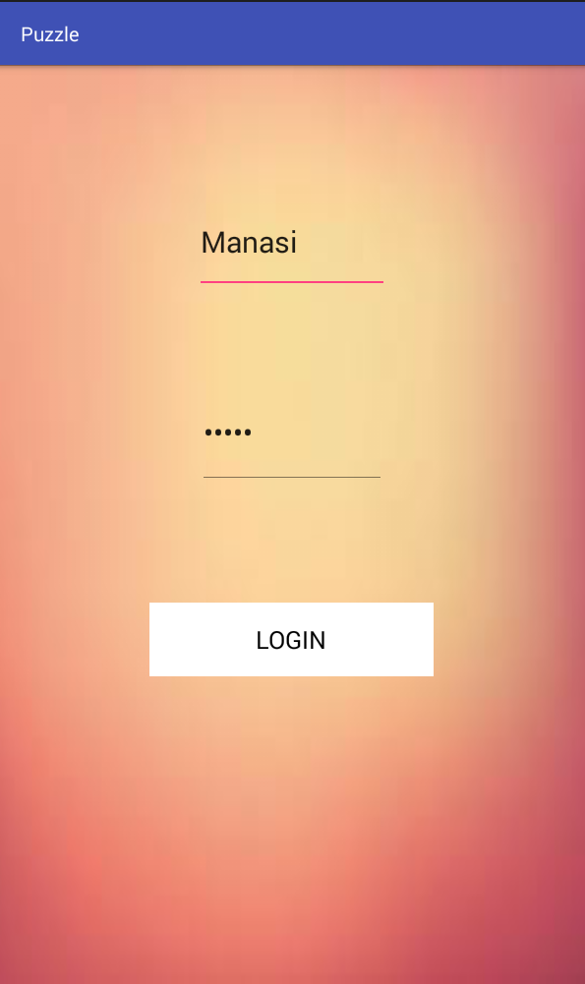
INPUT SCREENS

Slide 13
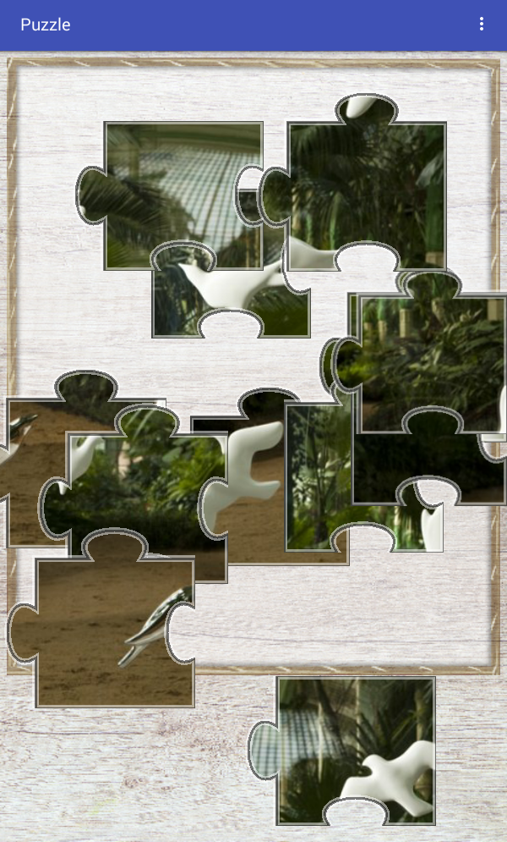
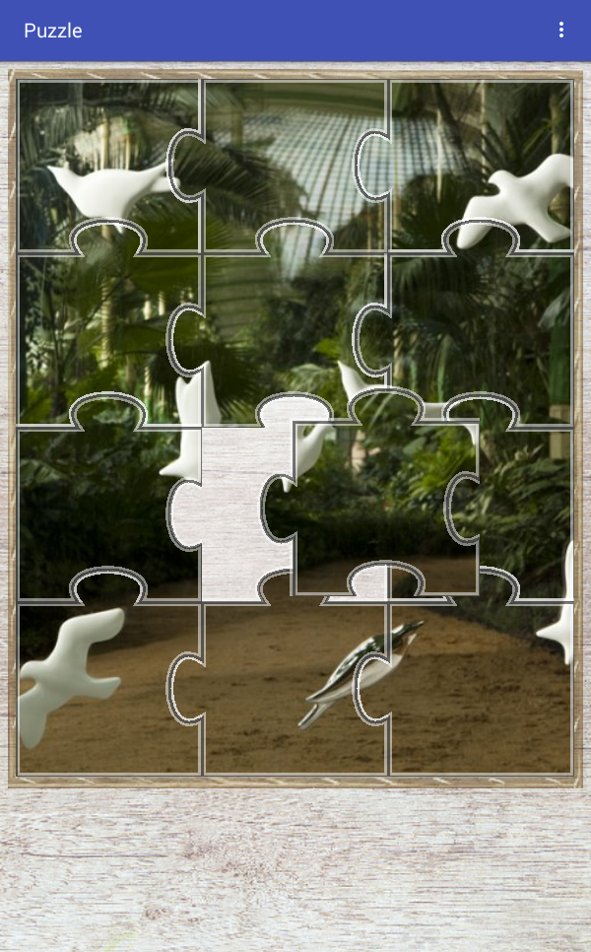
SCREENS

Slide 14
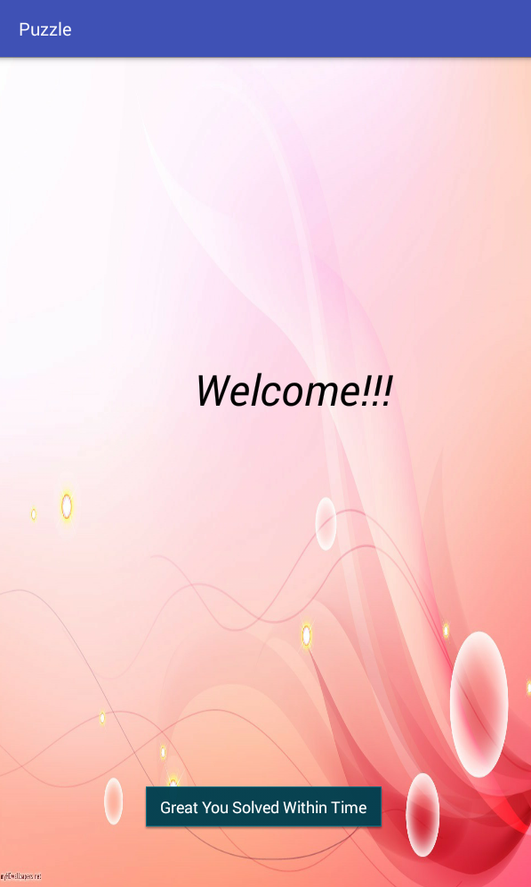
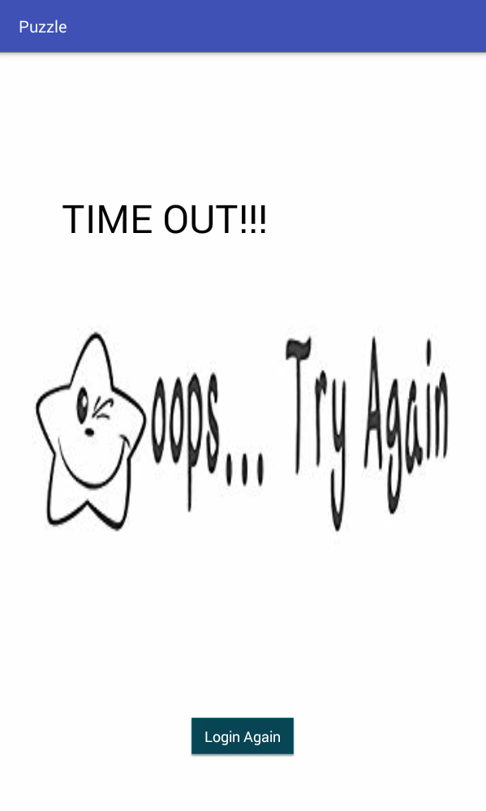

OUTPUT SCREENS

Slide 15
DRAWBACKS
Currently, there is no recovery option provided in case you forgot your password
Application is not linked to any database, so we have implemented our application for limited users

